Slide 1
Comparing Classification Models
Applying McNemar’s Test to Support Data Driven Model Selection
Dallas E. Taylor
Western Governors University

Slide 2
Project Overview
Why compare classification models?

Slide 3
Organizational Need
How do we effectively compare classification models?
  Comparison of means and standard deviation – leaves out statistical rigor
  Training time, production response latency, interpretability
  Statistical testing – tells us when differences matter
Combining all three into a holistic decision-making process
  Narrow model focus early – rigorous training and statistical comparison leads to holistic consideration of models
Machine Learning practitioners need a standard, data-driven method

Slide 4
Methodology Overview
Project provides a methodological implementation for classifier comparison. Functions for:
  Model training and tuning with nested k-fold cross-validation
  Model performance and predictions data sets
  Performance analysis – clustered bar charts, comparison of metric means
  Statistical analysis – McNemar’s test, heatmap showing pairwise matchups

Slide 5

Hypothesis
$H_{0}$ - There is no statistically significant difference in the performance of each model pair being compared.
$H_{a}$ - There is a statistically significant difference in the performance of model pairs.

Slide 6
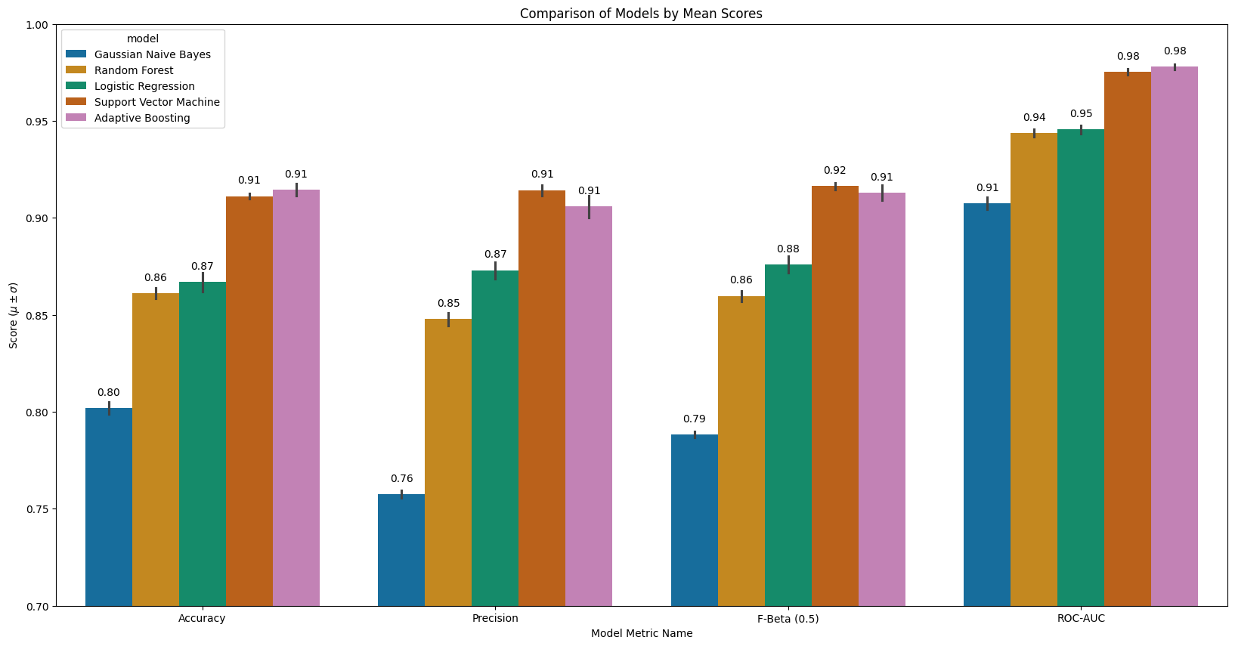
Classic Comparison of Means

Slide 7
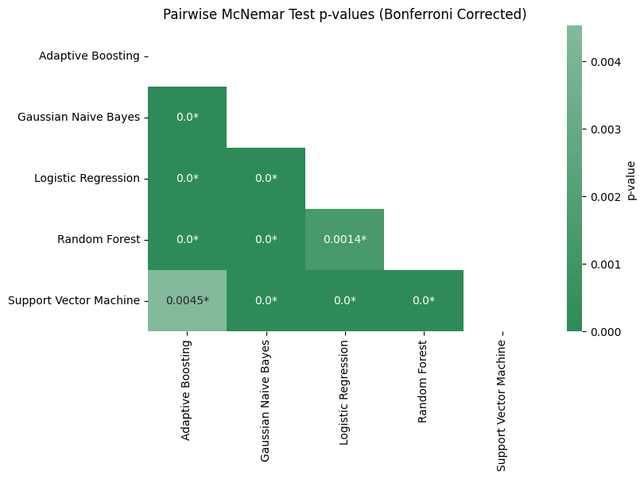
Heatmap Comparison: P-values vs Threshold

